Slide 1

OpenCL for MIC Architectural Overview
Dmitry Kaptsenel November 14, 2011
Software and Solutions Group (SSG) /
Visual Computing Division (VCD)

Slide 2


Plug-in into OpenCL Runtime
User Application
OpenCL Runtime API
OpenCL Runtime
CPU Device
Command Queue
OpenCL Device Agent
Platform Info/Control
Command Queue
Device Compiler
Command Queue
Command Queue
Execution Manager
Buffers Management
Command Queue
Buffer Manager
Command Queue
Command Queue
OpenCL C Language Compiler
Command Queue
PCI
MIC Device
MIC Card
Device Compiler
OpenCL Device Agent
Execution Manager
Buffer Manager
User OS Process

Slide 3
MIC Device as an Integration Project
PCI
OpenCL Runtime
MIC Device Agent Host part
MIC Device Agent Device part
TBB API
OpenCL API
DA <> Runtime API
COI API
COI API
TBB
COI
COI
DA <> Backend API
DA <> Backend API
MIC Backend Host part
MIC Backend Device part
Host Process
Device Process

Slide 4
Major Component Responsibilities
OpenCL Runtime
OpenCL API implementation – Runtime API, OpenCL C language
MIC Backend
Host part – device-specific kernels optimizations and code generation
Device part – single WorkGroup kernel execution maintenance
COI
Low level device memory management
Device process management
Pipelining execution requests to device
Cross-PCI communication
TBB
Parallel execution management
MIC Device Agent
Orchestrating all device-specific activities

Slide 5
Device Process Startup and Crash Recovery
One Device process per physical device
Created as part of OpenCL Context creation
Do not preallocate buffers memory – use on-demand buffer memory allocation
Pros:
Allow physical device sharing between different OpenCL processes and users
Process startup is much faster
Cons:
Each NDRange command invocation will bear device memory pinning overhead
NDRange execution may fail because lack of buffer memory as other Device processes also allocate Device physical memory
There is no memory swapping support (by µOS) on device
Crash recovery approach:
Report failure for all pending operations to Runtime. Fail all MIC devices for now, analyze possibility to limit failure to a single MIC Device in future.
Fail all DA API calls except of DA removal
Require user to recreate all OpenCL Contexts that referenced failed physical devices.

Slide 6
Working Modes
Single Device Mode
MIC is the only device in an OpenCL Context. Very like current CPU Device mode.
Multiple MIC devices in the same OpenCL Context
Multiple MIC Device Agents – one per physical device
A dedicated device process - one per device
Global Memory Objects management is done by OpenCL Runtime
Use single MIC Memory Manager instance to incorporate global Device Memory view by COI
Low level data movement is done by COI using inter-device and host-device DMA request
Heterogeneous CPU + MIC device/s in the same OpenCL Context
Very like multiple MIC devices
Allow MIC DMA engines to access CPU data directly to avoid extra in-main-memory data movement

Slide 7
Kernel Compilation Model
Compilation/linking is done on host, execution on device
Final linkage may happen on device to access low level services
Minimum compilation entity is OpenCL Program
Program transfer is done as part of Program Build sequence
Device executable memory is allocated using MIC DA device side service
Program is never unloaded from device until direct Runtime request
Multiple Programs may coexist on the same device

Slide 8
Memory Object Model
Runtime Memory Object – buffer/image representation in Runtime
Device Memory Object - buffer/image representation in Device Agent
Sharing Group – all Device Agents that share the same instance of Device Memory Object inside single Runtime Memory Object (ex. multiple MIC Devices in the same OpenCL Context). Sharing Group unique ID is reported by DA per Memory Object type (buffer/image/etc.)
Backing Store – raw data buffer for inter-device/device-runtime communication managed by Runtime. Each device may use this buffer directly for data storage (ex. CPU Device) or maintain its own data copy. Runtime may use this buffer for data mappings or maintain its own data copy (ex. unaligned buffers support)
Backing Store Raw Memory
Sharing Groups
Runtime Memory Object
Device Agent Reference
Device Memory Object Shared by the Whole Sharing Group

Slide 9
Sharing/Transferring Data between devices in the same Context Track most updated data location and move up-to-date data to required location.
Instruction sequences for data movement
Implemented by Runtime
Requires ownership and data validity tracking
Owner/s – last device or group of devices that executed Kernel with write permission to the specific Memory Object or copied-to/wrote-to/filled/write-mapped the Memory Object
Backend may help to lower memory copy overhead by providing Read/Write usage info inside kernel code.

Slide 10
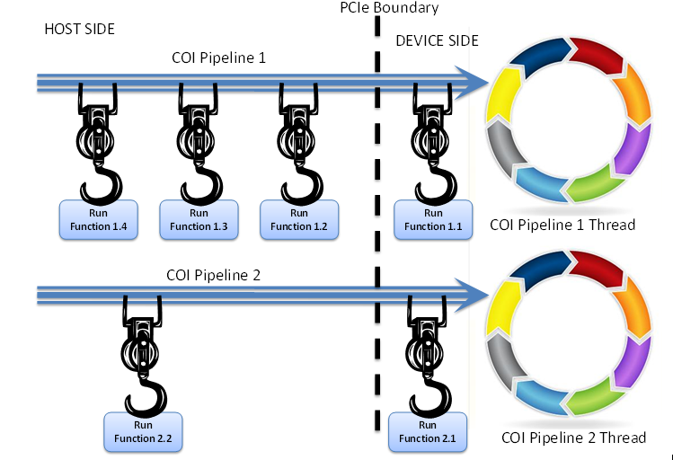
Command Lists Model
Each Command List is represented as COI Pipeline with dedicated device thread.
NDRange is mapped to COI Run-Function (device-side func) invocation.
Memory Object Operations (Read/Write/Map/UnMap) are implemented as COI Buffer operations which are mapped onto DMA invocations from host.
Not associated with COI Pipelines
COI Events used to enforce ordering between COI Buffer operations and between COI Buffer and COI Pipeline operations
Out-of-Order NDRanges are implemented by COI Run-Functions that launch kernels asynchronously and immediately return.
Command List | ⇨ | COI Pipeline
NDRange | ⇨ | COI Run-Function
Buffer/Image | ⇨ | COI Buffer

Slide 11
Device Callbacks Support
Asynchronous notifications and callbacks from Device Agent back to Runtime are implemented using Notification Port pattern
Current implementation uses single Notification Port per physical device
Notification Port is a thread that waits endlessly for any registered COI Event and calls associated callback after some COI Event was signaled.
MIC Device Agent associate distinct COI Event with each outstanding COI operation.
Event signaling is done by either COI itself as operation is completed or by explicit COI API call at device side.
Important limitations:
Notification Port is a serialization point for device.
It is possible to create dedicated Notification Port per Command List if required.
Long operations in callbacks inside Runtime (like buffer copy or inter-thread communication) will influence overall device throughput or even cause a deadlock (inter-thread communication).

Slide 12
Printf() inside kernels support
MIC DA allocates new COI Buffer with limited size for each NDRange command that uses printf()
As kernel calls printf() function Backend invokes MIC DA device side callback with relevant string and string size.
MIC DA device side callback copies the string to the specific buffer atomically.
** Avoid Work Items output intermixing to ease debugging **
After NDRange command finished and appropriate COI Event in Notification Port is signaled MIC DA host side will copy printf() buffer to the host and invoke appropriate Runtime service to consume the data.

Slide 13
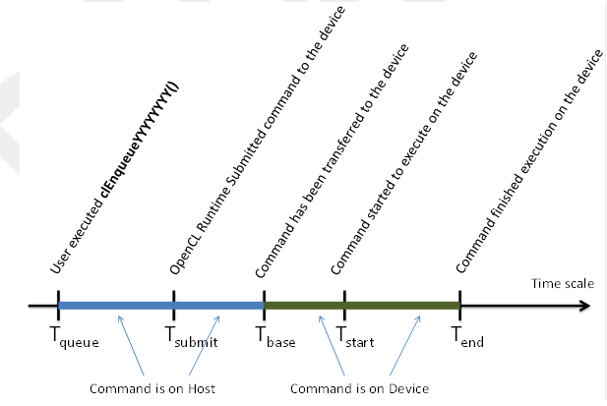
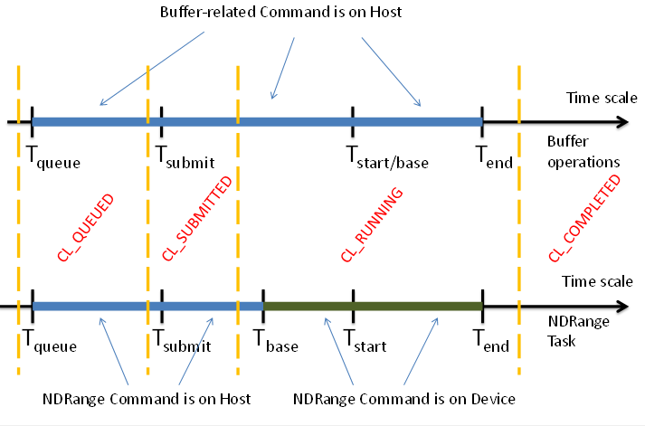
Performance Counters Support
Data is collected per-NDRange or per-Buffer op and reported using Runtime callbacks
Time is measured partially on host side and partially on device side
Converted to host time during Completion Notification
Runtime to provide API for consuming all counters as part of Completion Notification.
Required to allow differentiation between CL_RUNNING command status change notification and T_{start} measurement.
COI to provide a way to record an execution start time as COI Buffer operation starts

Slide 14
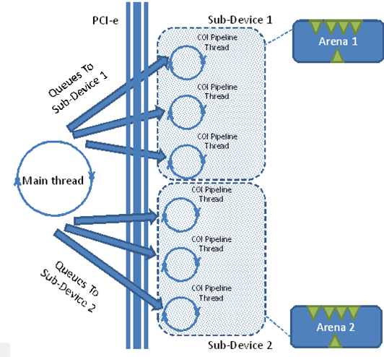
Device Tasking System - TBB
For In-Order Command Lists parallel_for() is invoked directly by COI Pipeline thread.
For Out-of-Order Command Lists commands are equeued into TBB queues and executed asynchronously.
Fission support:
Each sub-device is represented by single TBB Arena
Each COI Pipeline thread will use appropriate TBB Arena for execution
Each TBB Arena will use distinct set of HW execution units (HW Cores/Threads)

Slide 15
Device Info Highlights
CL_DEVICE_TYPE | CL_DEVICE_TYPE_ACCELERATOR
CL_DEVICE_MAX_COMPUTE_UNITS | Number of HW threads on device
CL_DEVICE_PREFERRED_VECTOR_WIDTH_* | 1 to allow efficient auto-vectorization
CL_DEVICE_NATIVE_VECTOR_WIDTH_* | 512 bits
CL_DEVICE_HOST_UNIFIED_MEMORY | CL_FALSE
CL_DEVICE_GLOBAL_MEM_SIZE | ¾ of device physical memory size
CL_DEVICE_MAX_MEM_ALLOC_SIZE | ¼ of Global
CL_DEVICE_MEM_BASE_ADDR_ALIGN | 512 bytes – maximum alignment of KNF/KNC vector instructions
CL_DEVICE_MAX_SAMPLERS | Number of HW TXS units (after TXS units support will be added)
CL_DEVICE_SINGLE_FP_CONFIG (KNC) | DENORM, INF_NAN, ROUND_TO_NEAREST, ROUND_TO_ZERO, ROUND_TO_INF, FMA
CL_DEVICE_DOUBLE_FP_CONFIG (KNC) | DENORM, INF_NAN, ROUND_TO_NEAREST, ROUND_TO_ZERO, ROUND_TO_INF, FMA
CL_DEVICE_EXTENSIONS | FP64, global/local/32/64/base/extended atomics, byte store, 3D image writes, device fission, GL sharing
CL_DEVICE_PARTITION_PROPERTIES | Equally, By Counts, By Affinity Domain
CL_DEVICE_PARTITION_AFFINITY_DOMAIN | L1 cache only (assume both L1 and L2 split KNF/KNC device into CPU Cores)

Slide 16
Outstanding Requirements from Backend and Runtime
Device BackEnd
Provide buffer kernel argument R/W usage attribute
Runtime
Consume printf() buffer after NDRange completion
Modify Device Querying and Creation APIs of Device Agents to support multiple top level device instances of the same type
Allow differentiation between CL_RUNNING command status change notification and Tstart measurement
TBB
Allow manual Arena creation and submitting tasks to arbitrary arenas by any application thread
COI
Relaxed buffers
Sub-buffers
Ability to measure buffer operation start
Process crash notification
Support Local Arena Observers

